Slide 1
Hotel Reviews
Presented by Torrey Capobianco

Slide 2
Online Hotel Reviews
Guests
Most private travel is booked online
Guests leave reviews to inform other guests and to provide feedback to hotel
93% of customers base booking decision from reviews they read
Hotel
Hotel managers look to online reviews to see perceptions of their hotels & the industry
Star ratings do not provide enough information
Reading through numerous reviews would not be efficient

Slide 3

Problem Statement
Reviews are looked at for a variety of hotels from across the United States
Are there common themes that guests associate with a positive experience and a negative experience?
Are there words that associate together more than others?
Do guests tend to leave more positive reviews than negative? Do they say more with one vs. the other?
A text mining approach is presented to answer these questions.
By looking at these reviews, hotel managers can gain a sense of what guests look for in choosing a hotel.
Managers can use this information for marketing, planning, and internal training.

Slide 4
The Data
Datafiniti’s Business Database
1,000 different hotels in the US
Hotel location and name
Date of review
Guest location
Numeric review rating
Text review
Data Cleaning
Removed duplicated reviews
Only reviews in English were accepted
Reviews with rating > 5 dropped
Rating | Score
1 – 2 | Negative
3 | Neutral
4 – 5 | Positive

Slide 5
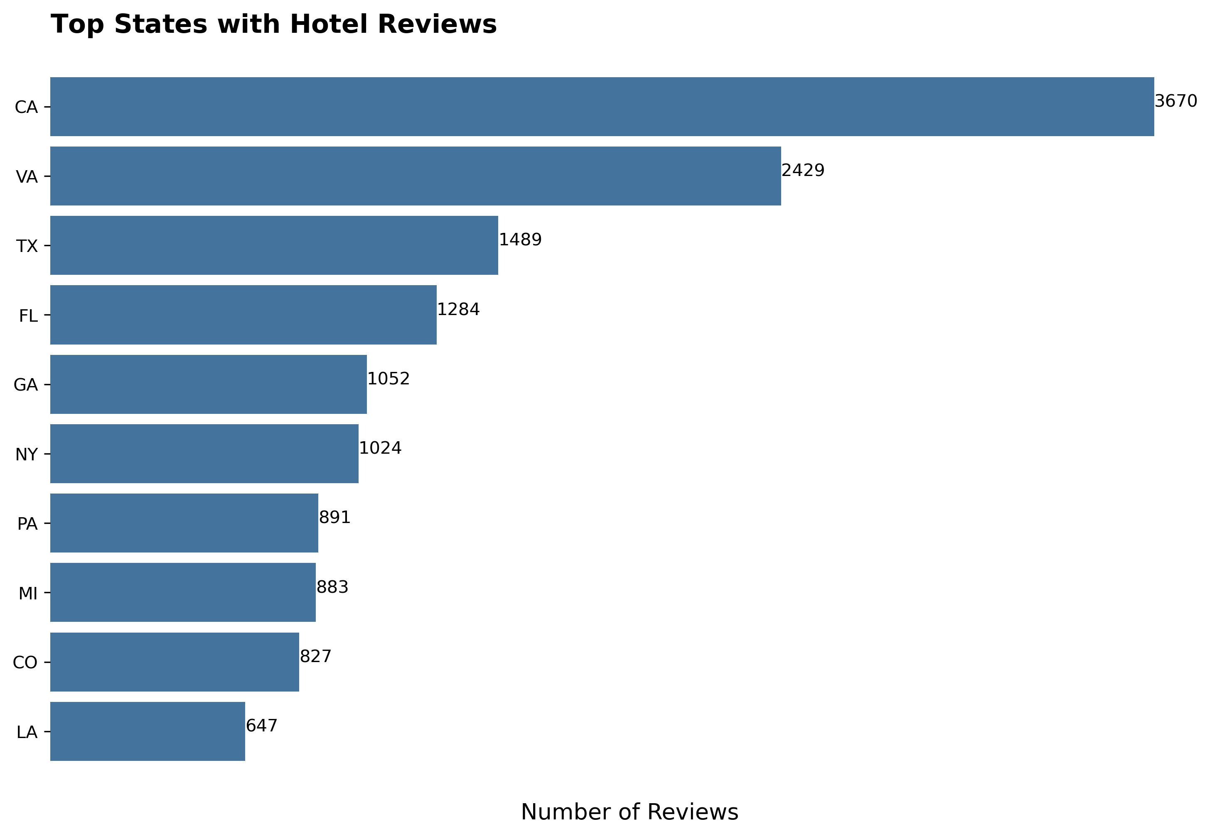
EDA
Hotels with most reviews
The Alexandrian, Autograph Collection
Howard Johnson Inn - Newburgh
Americas Best Value Inn

Slide 6
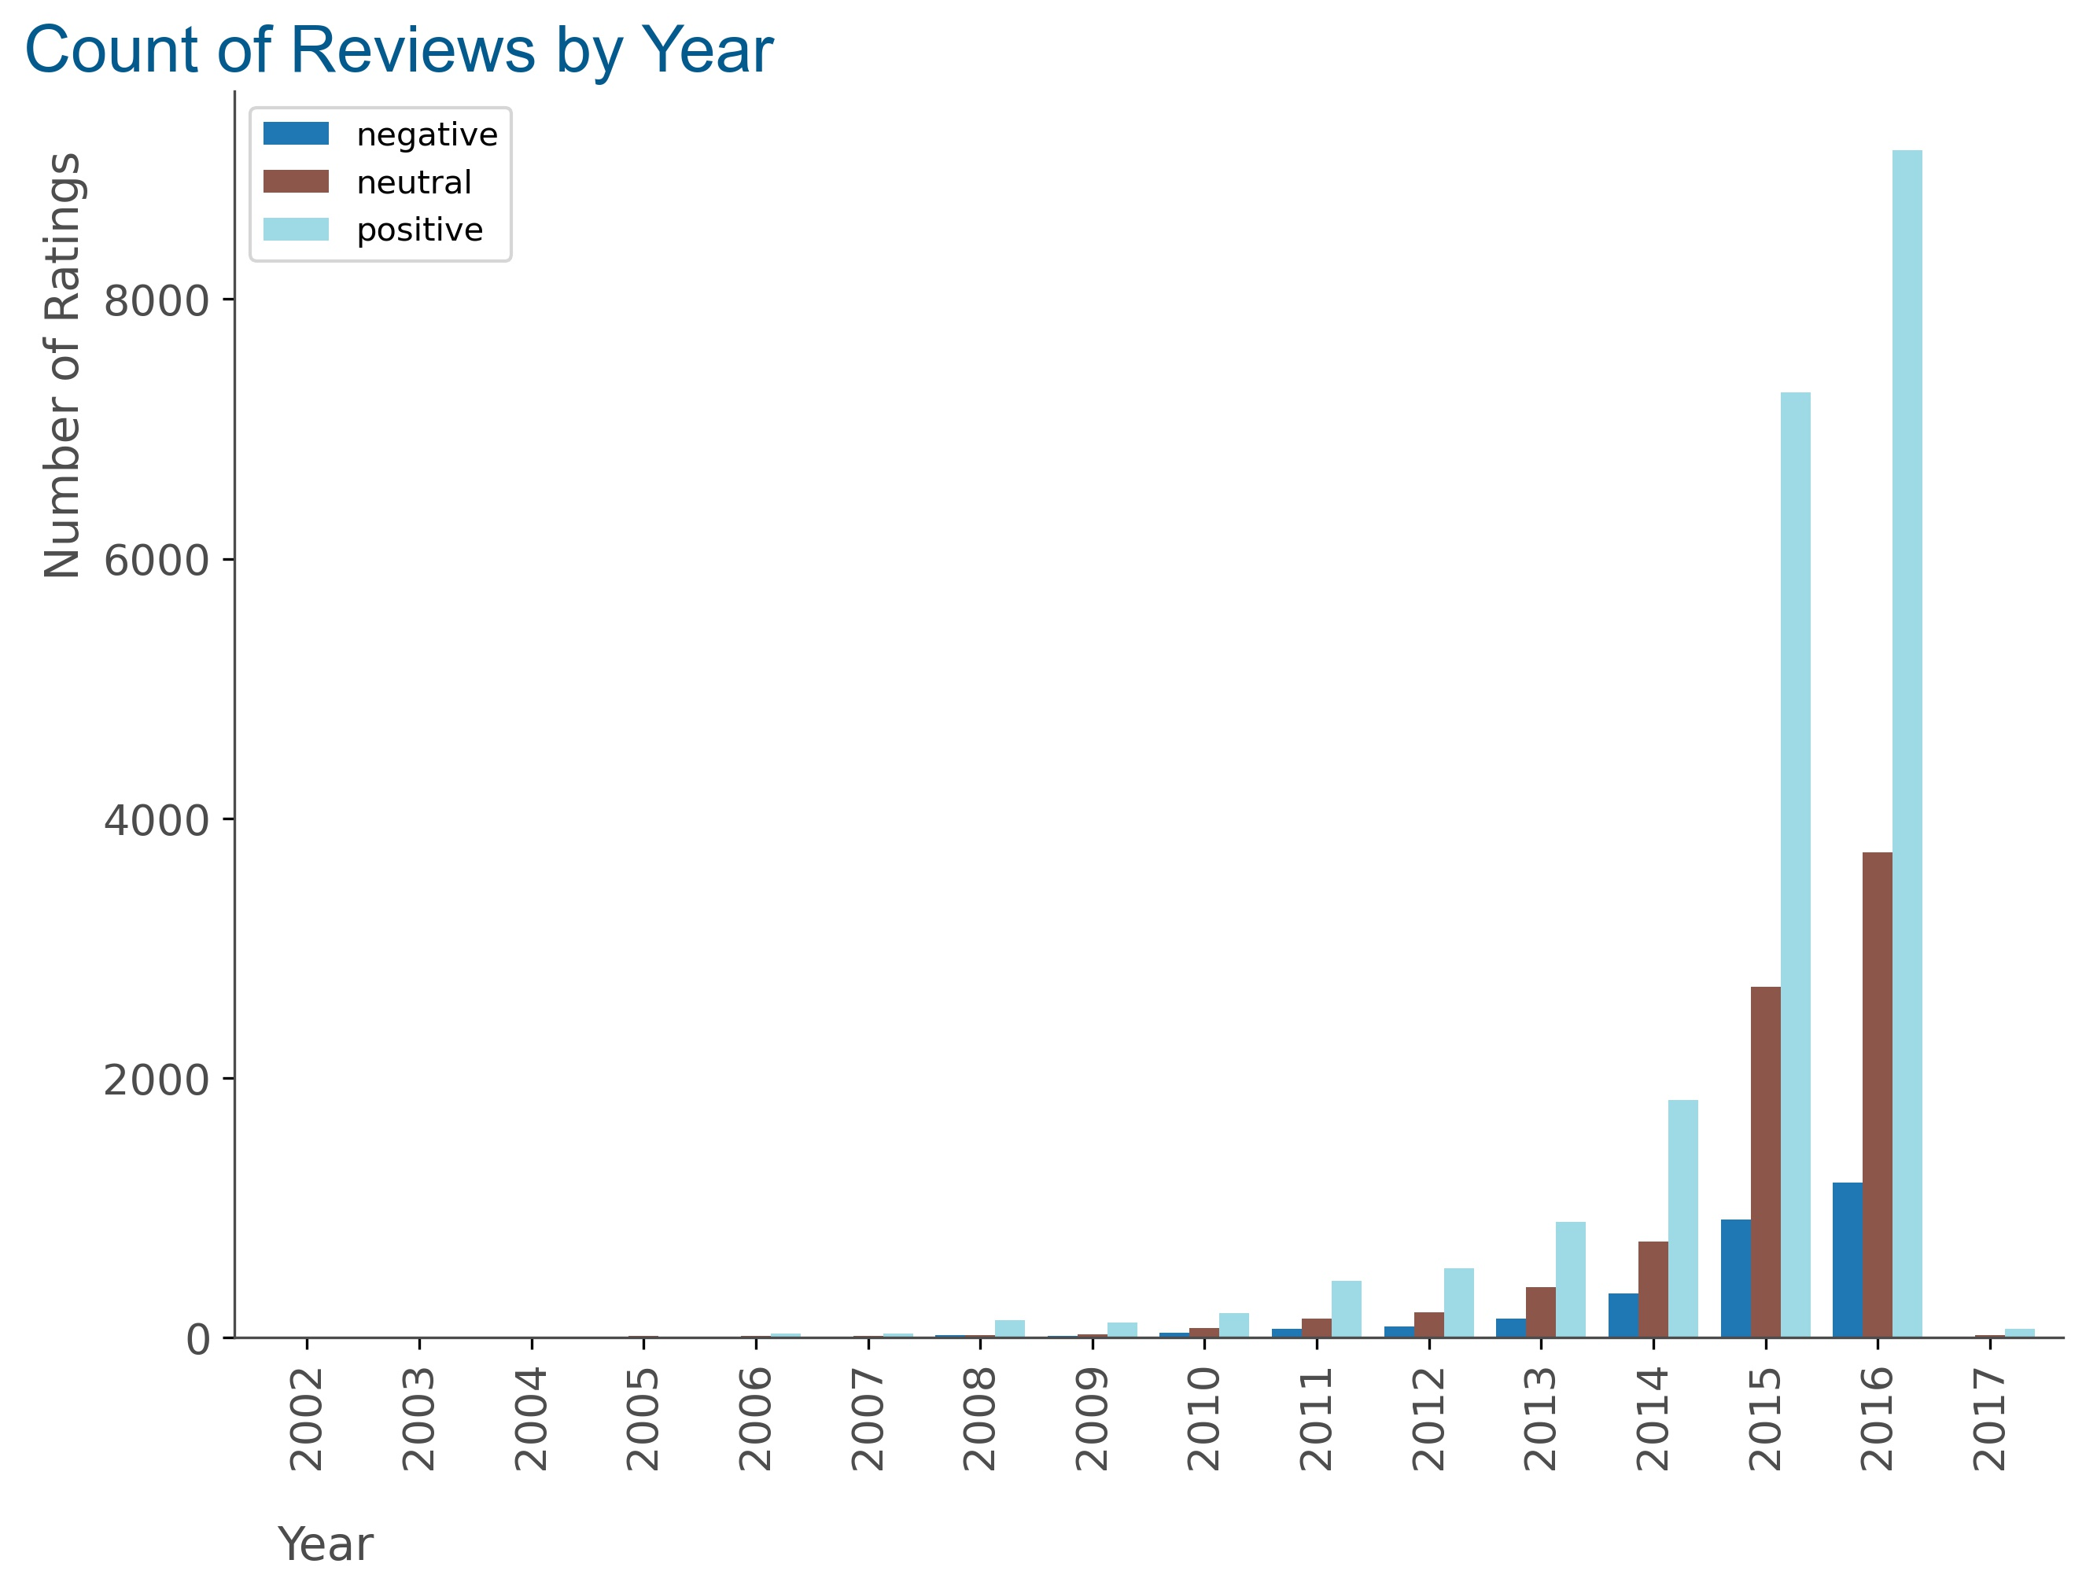

EDA
 | Positive | Negative
Word Count | 43 words | 64 words
Character Count | 239 characters | 339 characters

Slide 7
Text Pre-Processing
Steps
Lower case | The hotel → the hotel
Remove punctuations, numbers, white space | # ? - * & $ % 1234567890
Remove emoticons, emoji’s, URL links | :-) ☺ html://
Spell check words | restaurnt → restaurant
Normalization - Lemmatization | loved → love
Remove stop words | a, the, is, and, it

Slide 8
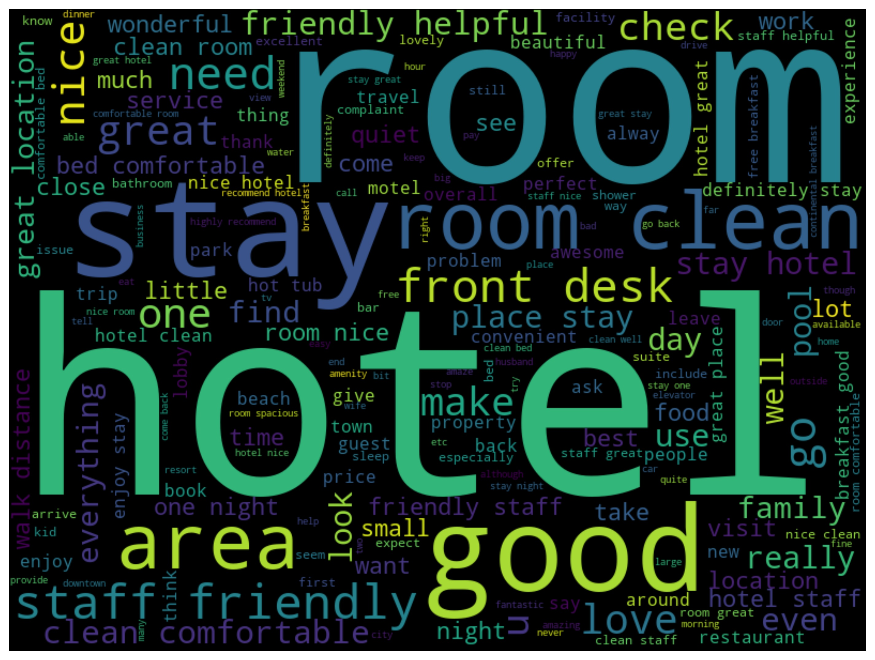
Text Mining Methods
Three Methods :
Term Frequency
Text-Link Analysis
Inverse Document Frequency

Slide 9
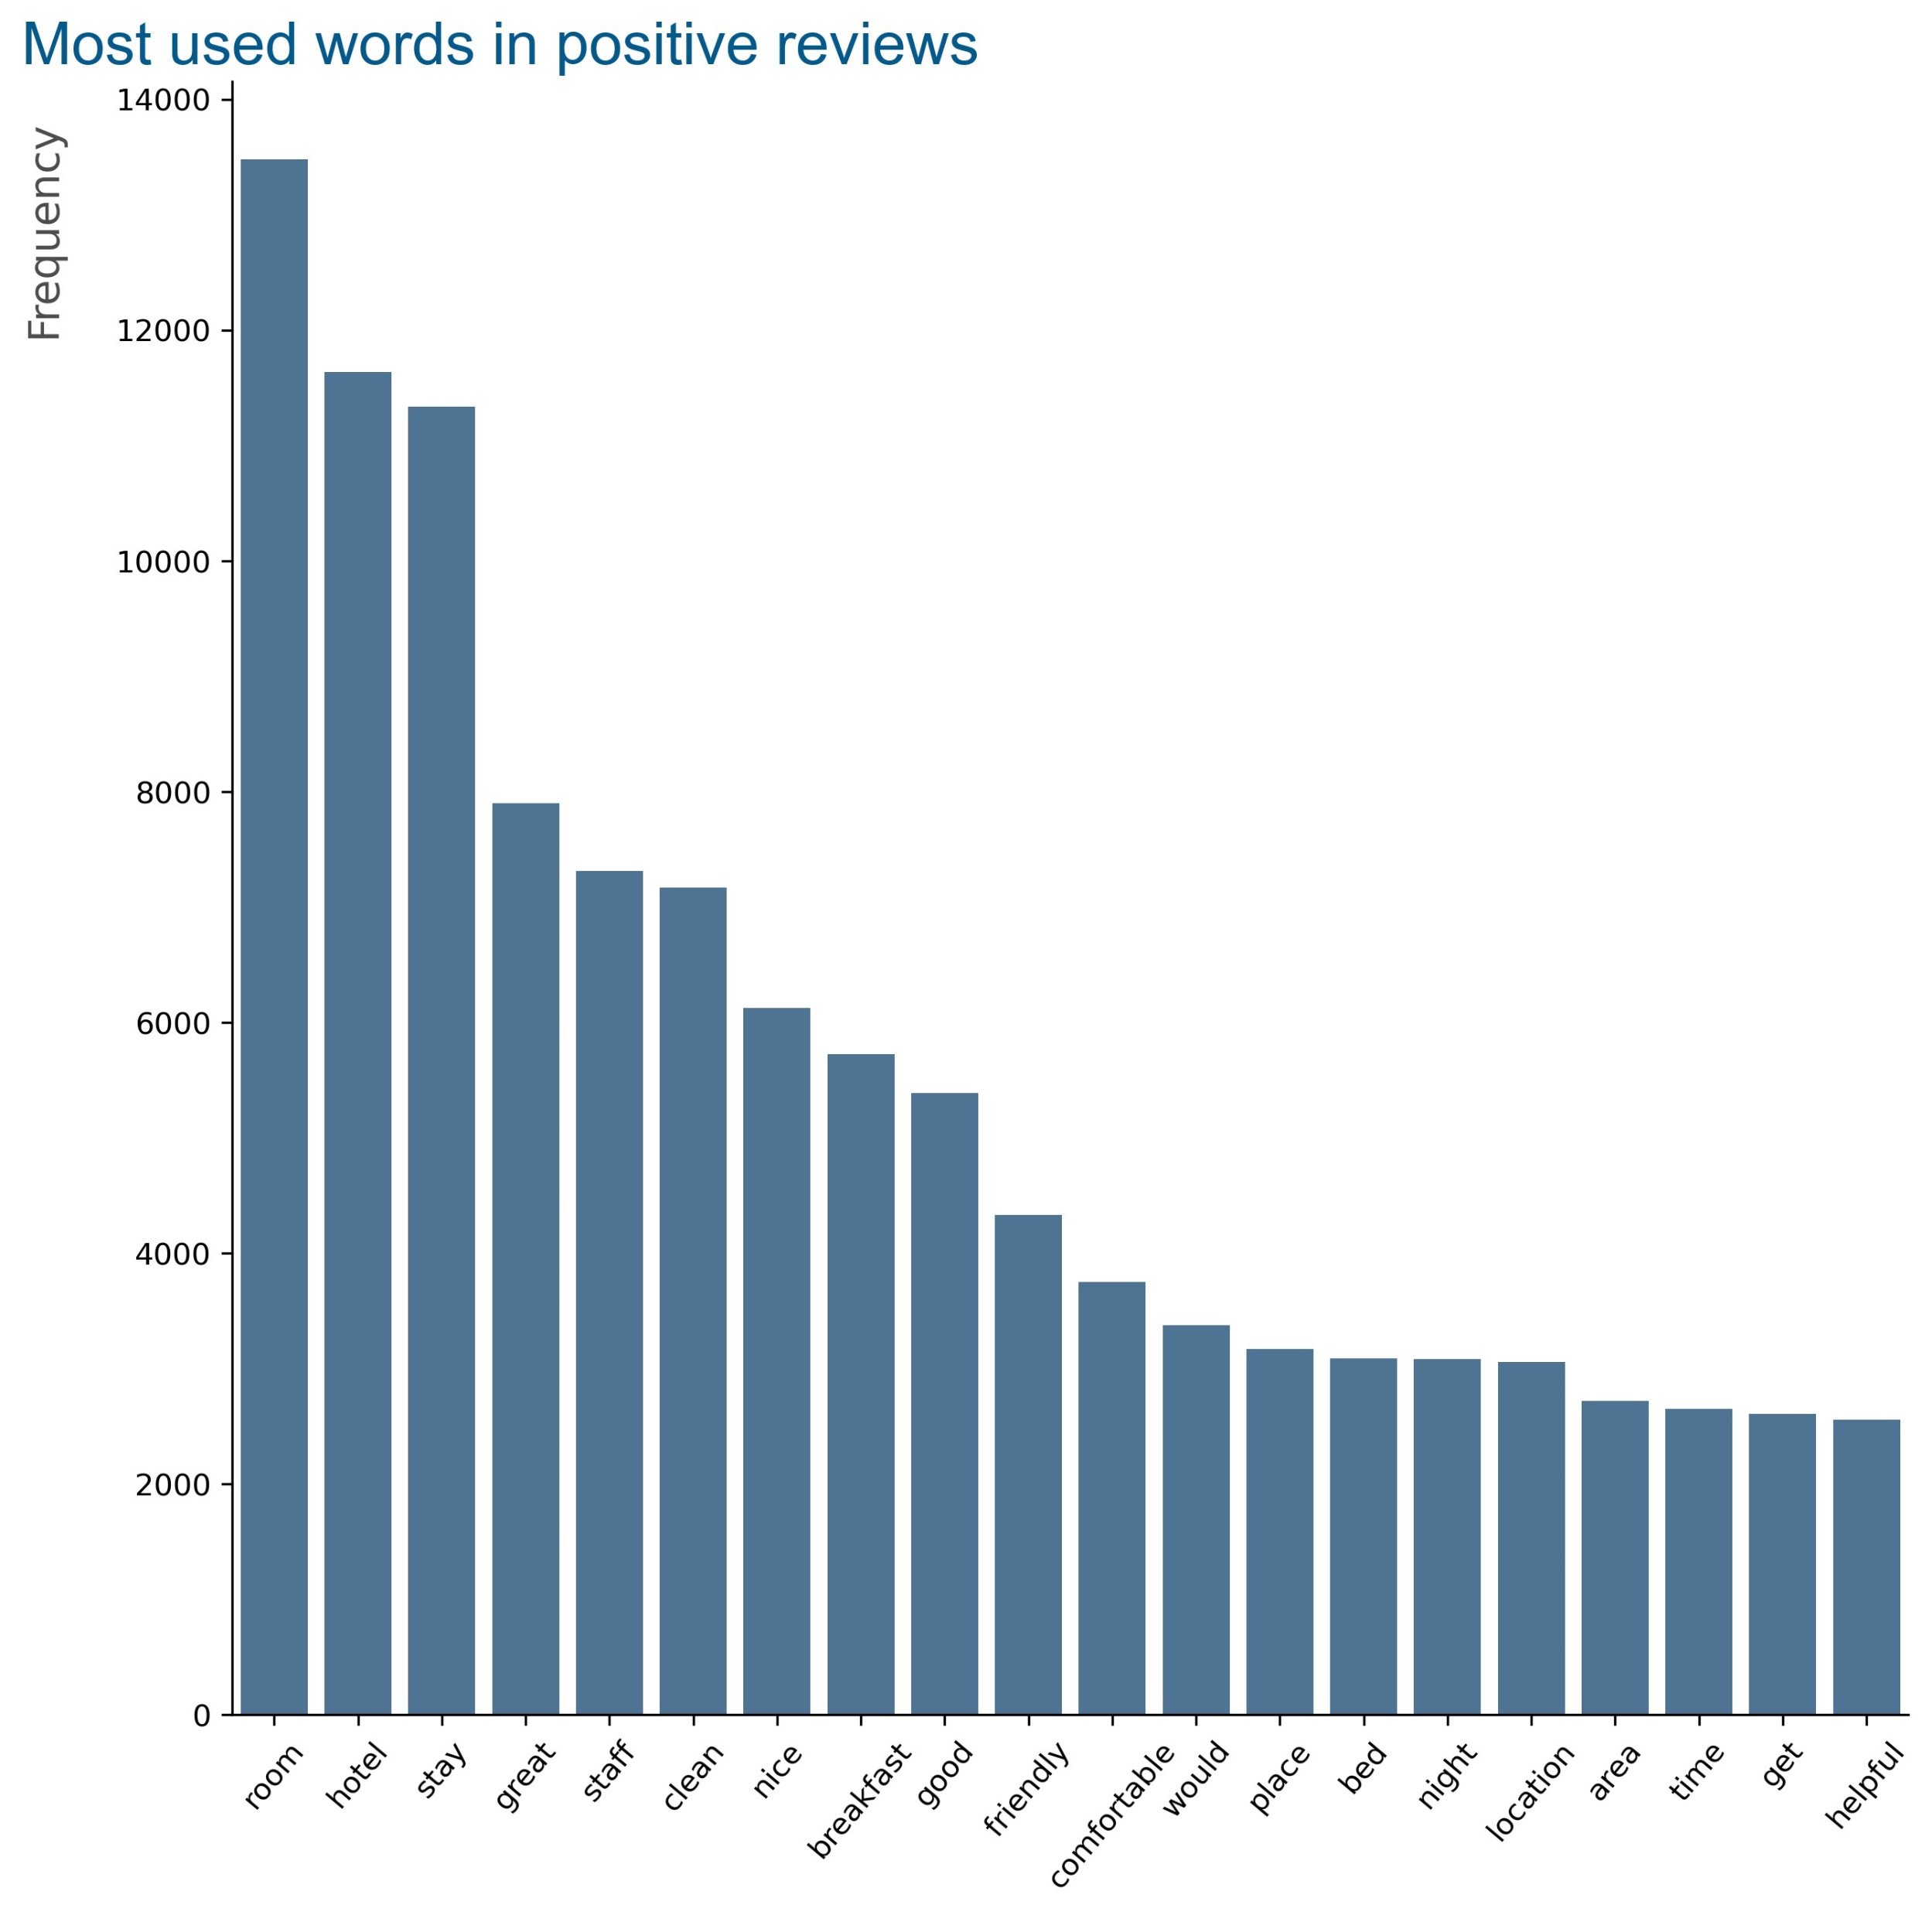
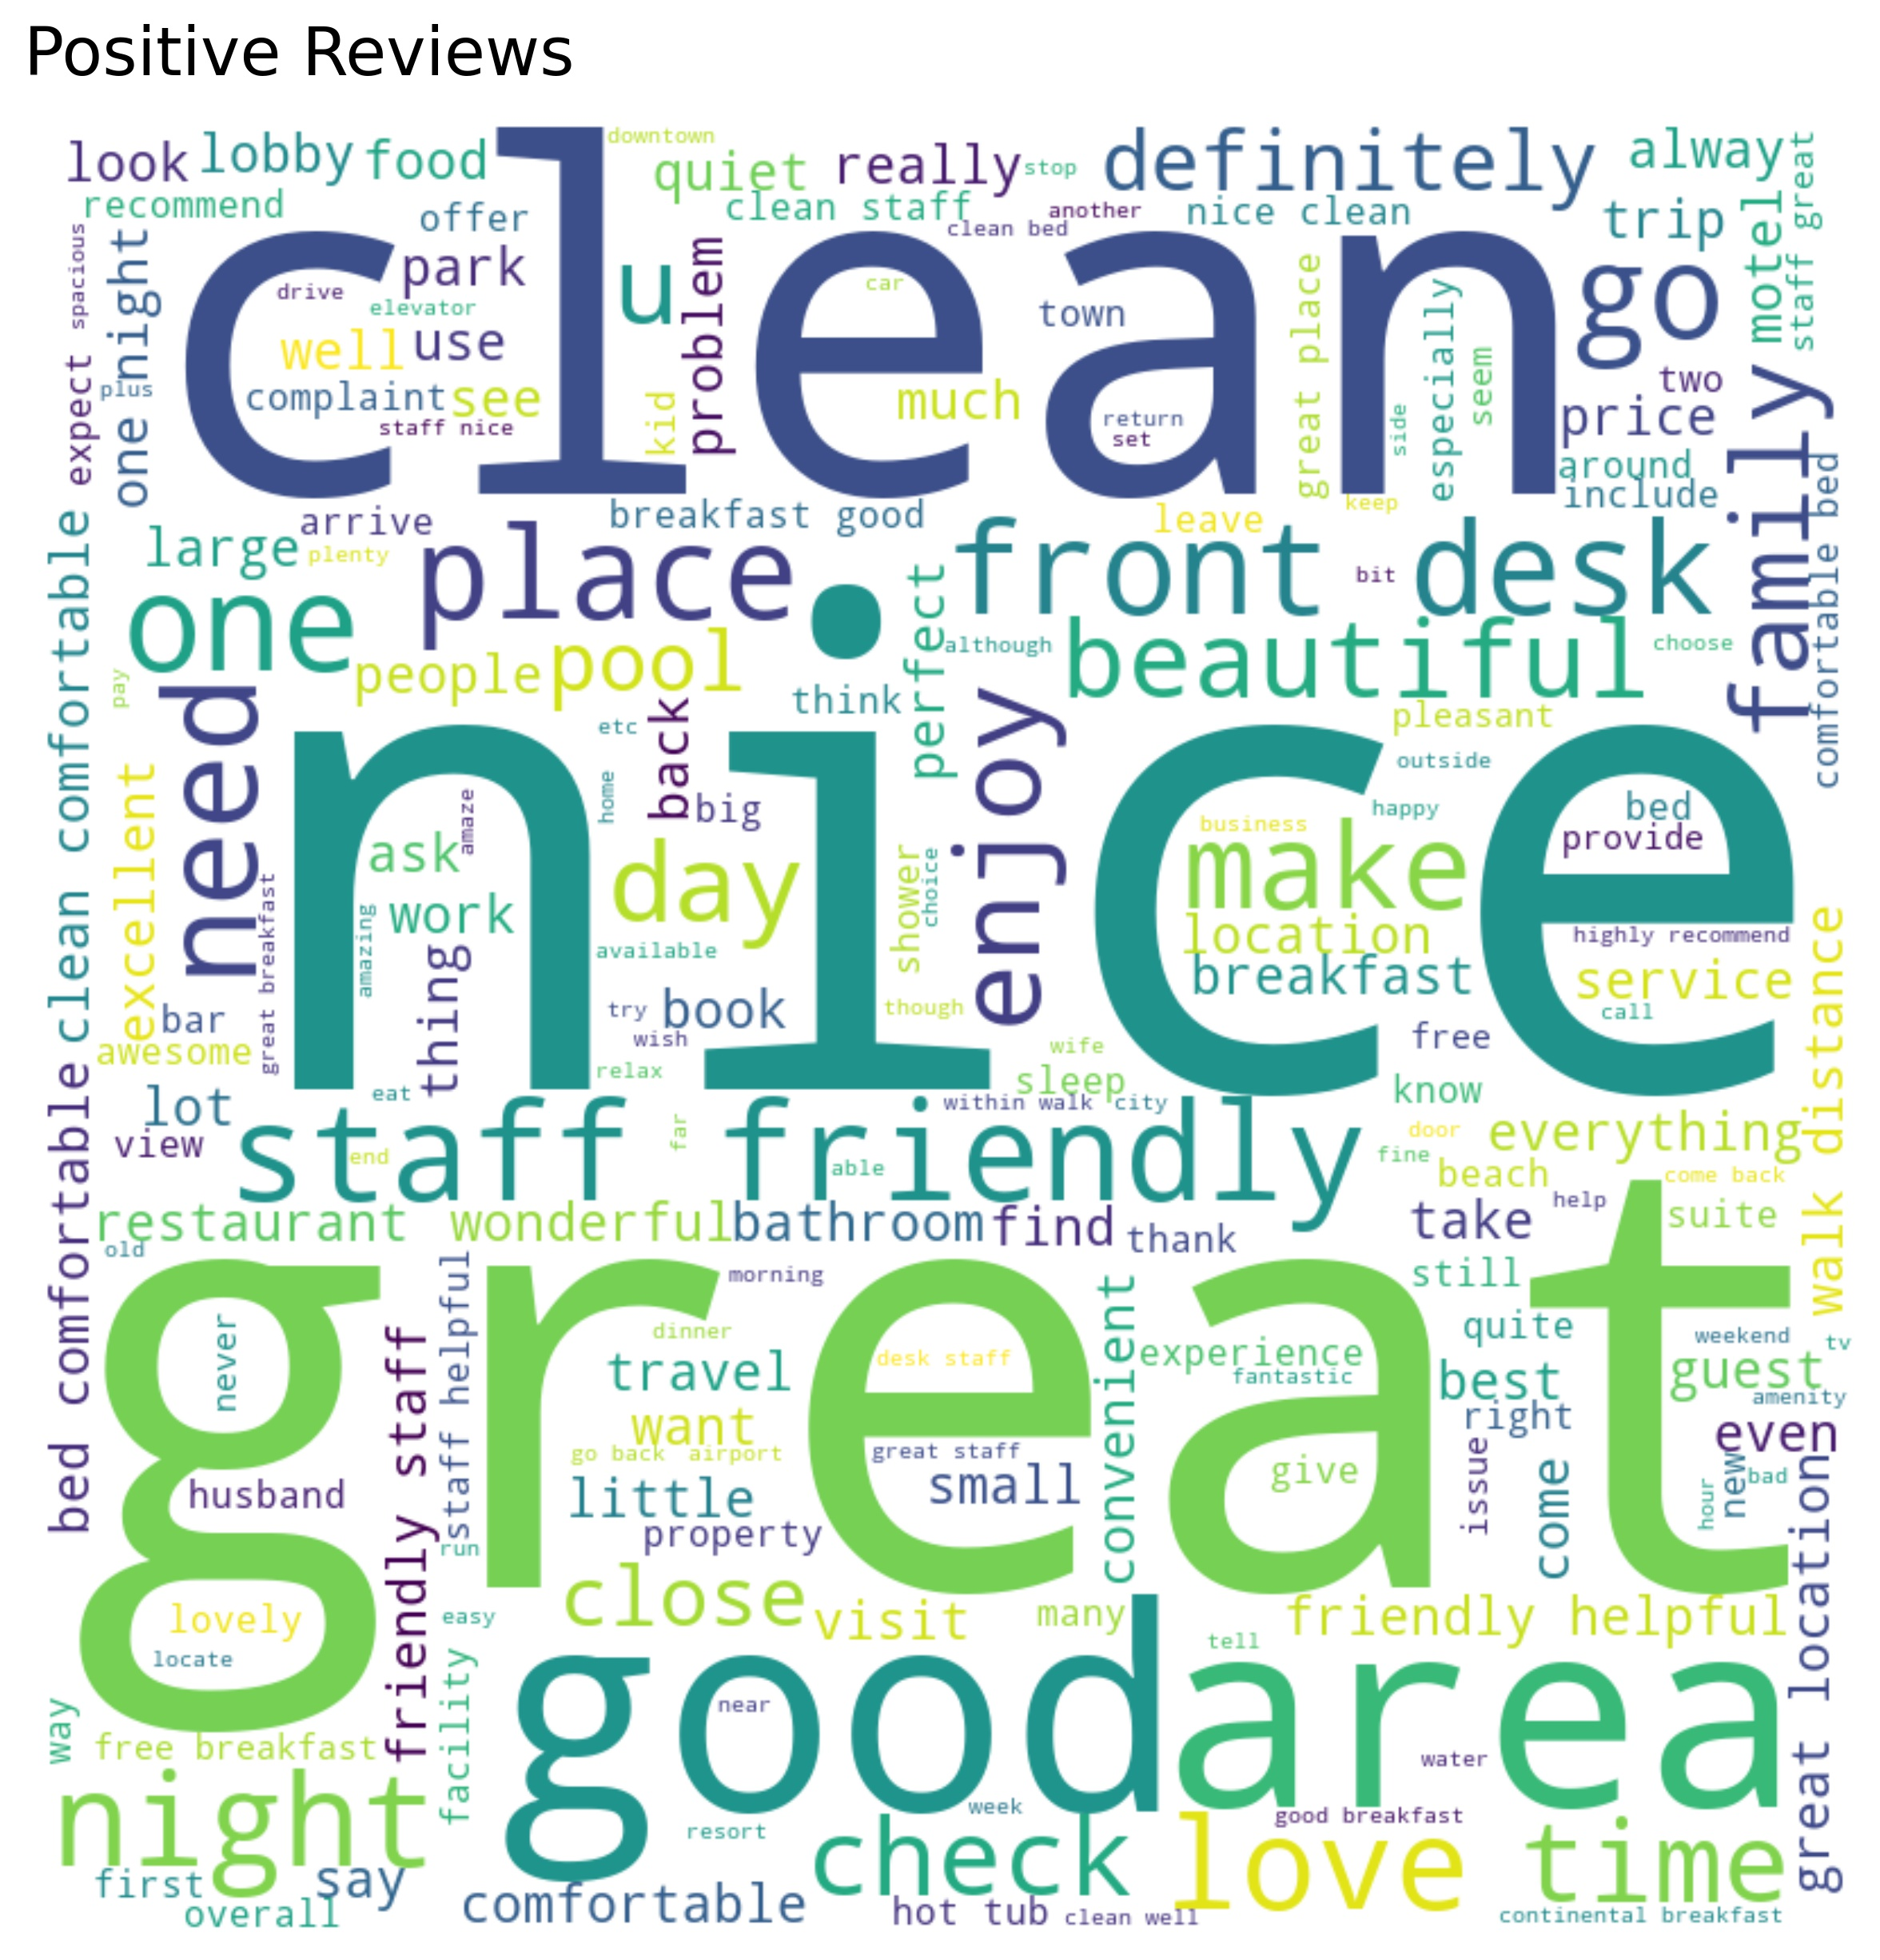
Term Frequency

Slide 10
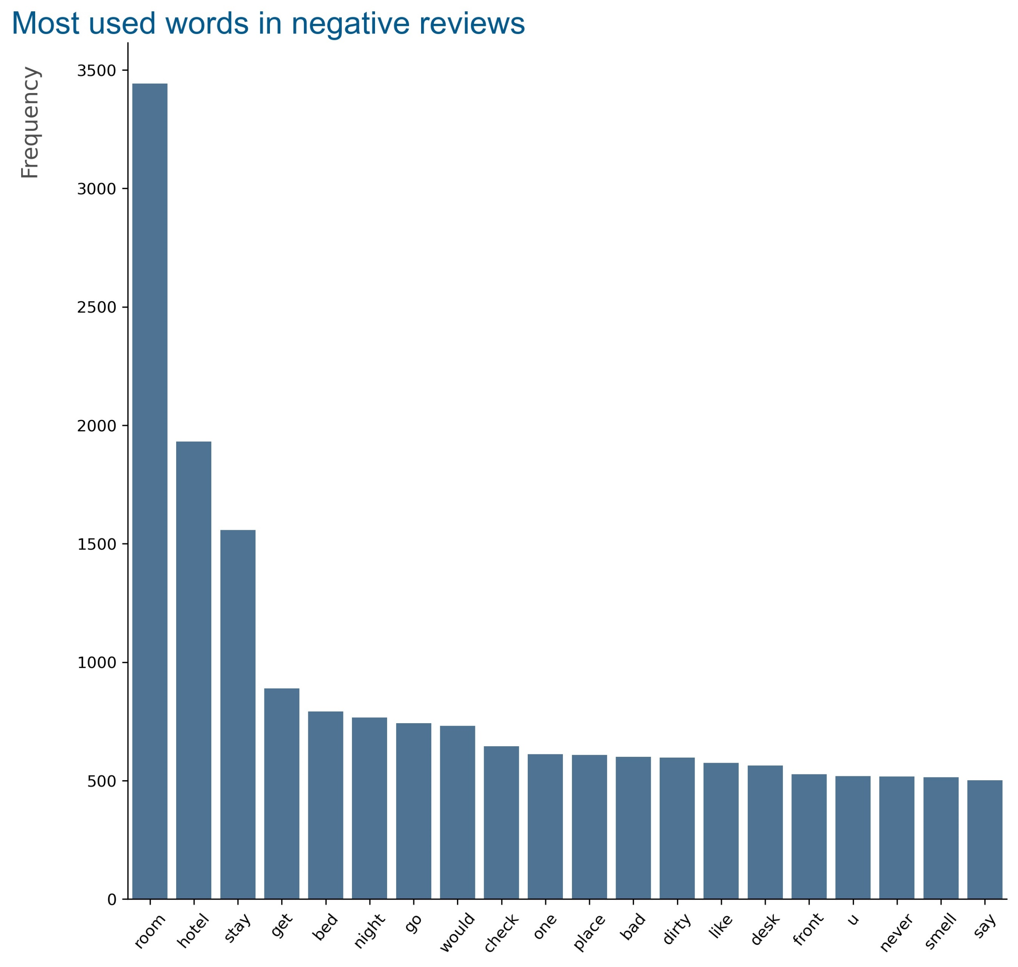
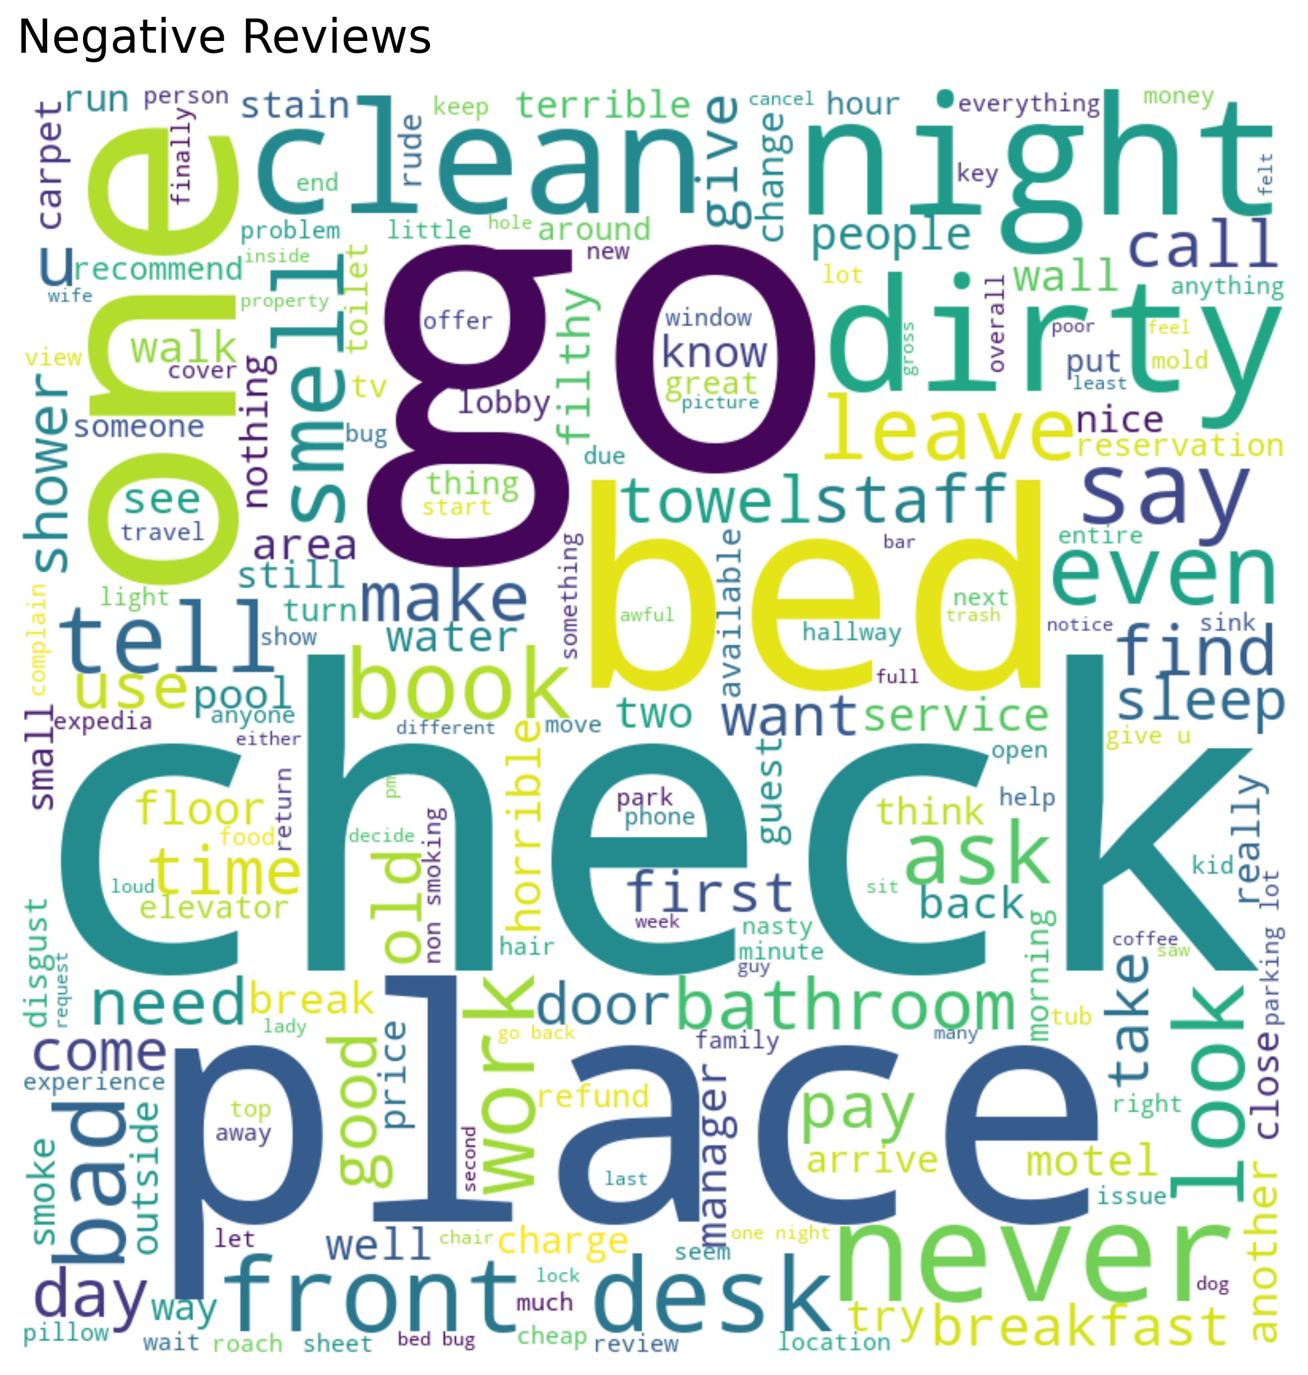
Term Frequency

Slide 11
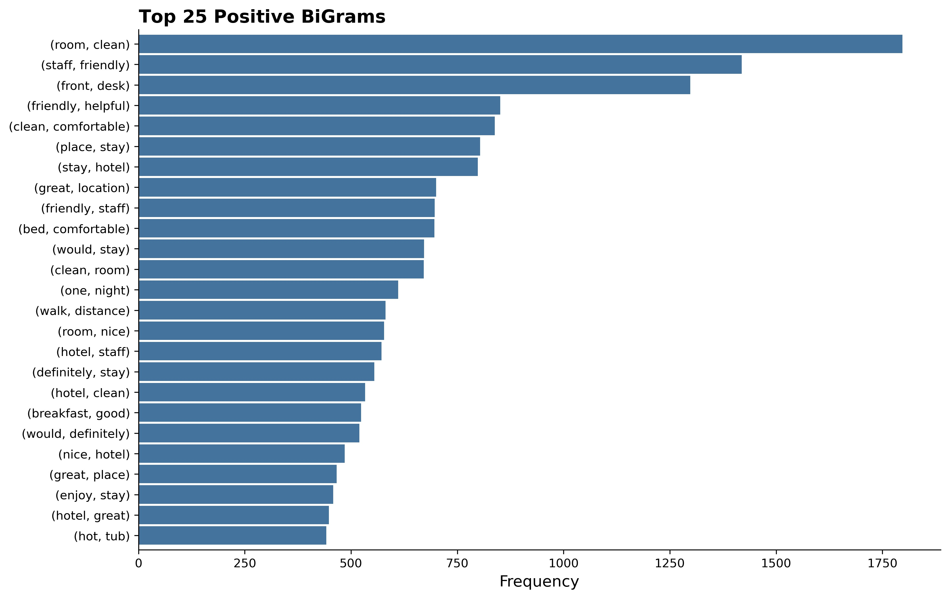
Text-Link Analysis: Positive
BiGram Feelings
Nice -
Breakfast
Staff
Hotel
Clean
Pool
Touch
Place
Room -
Clean
Comfortable
Spacious
Large
Small
Service
1797
1419
1298
851
TriGram Feelings
Need -
Comfortable Bed

Slide 12
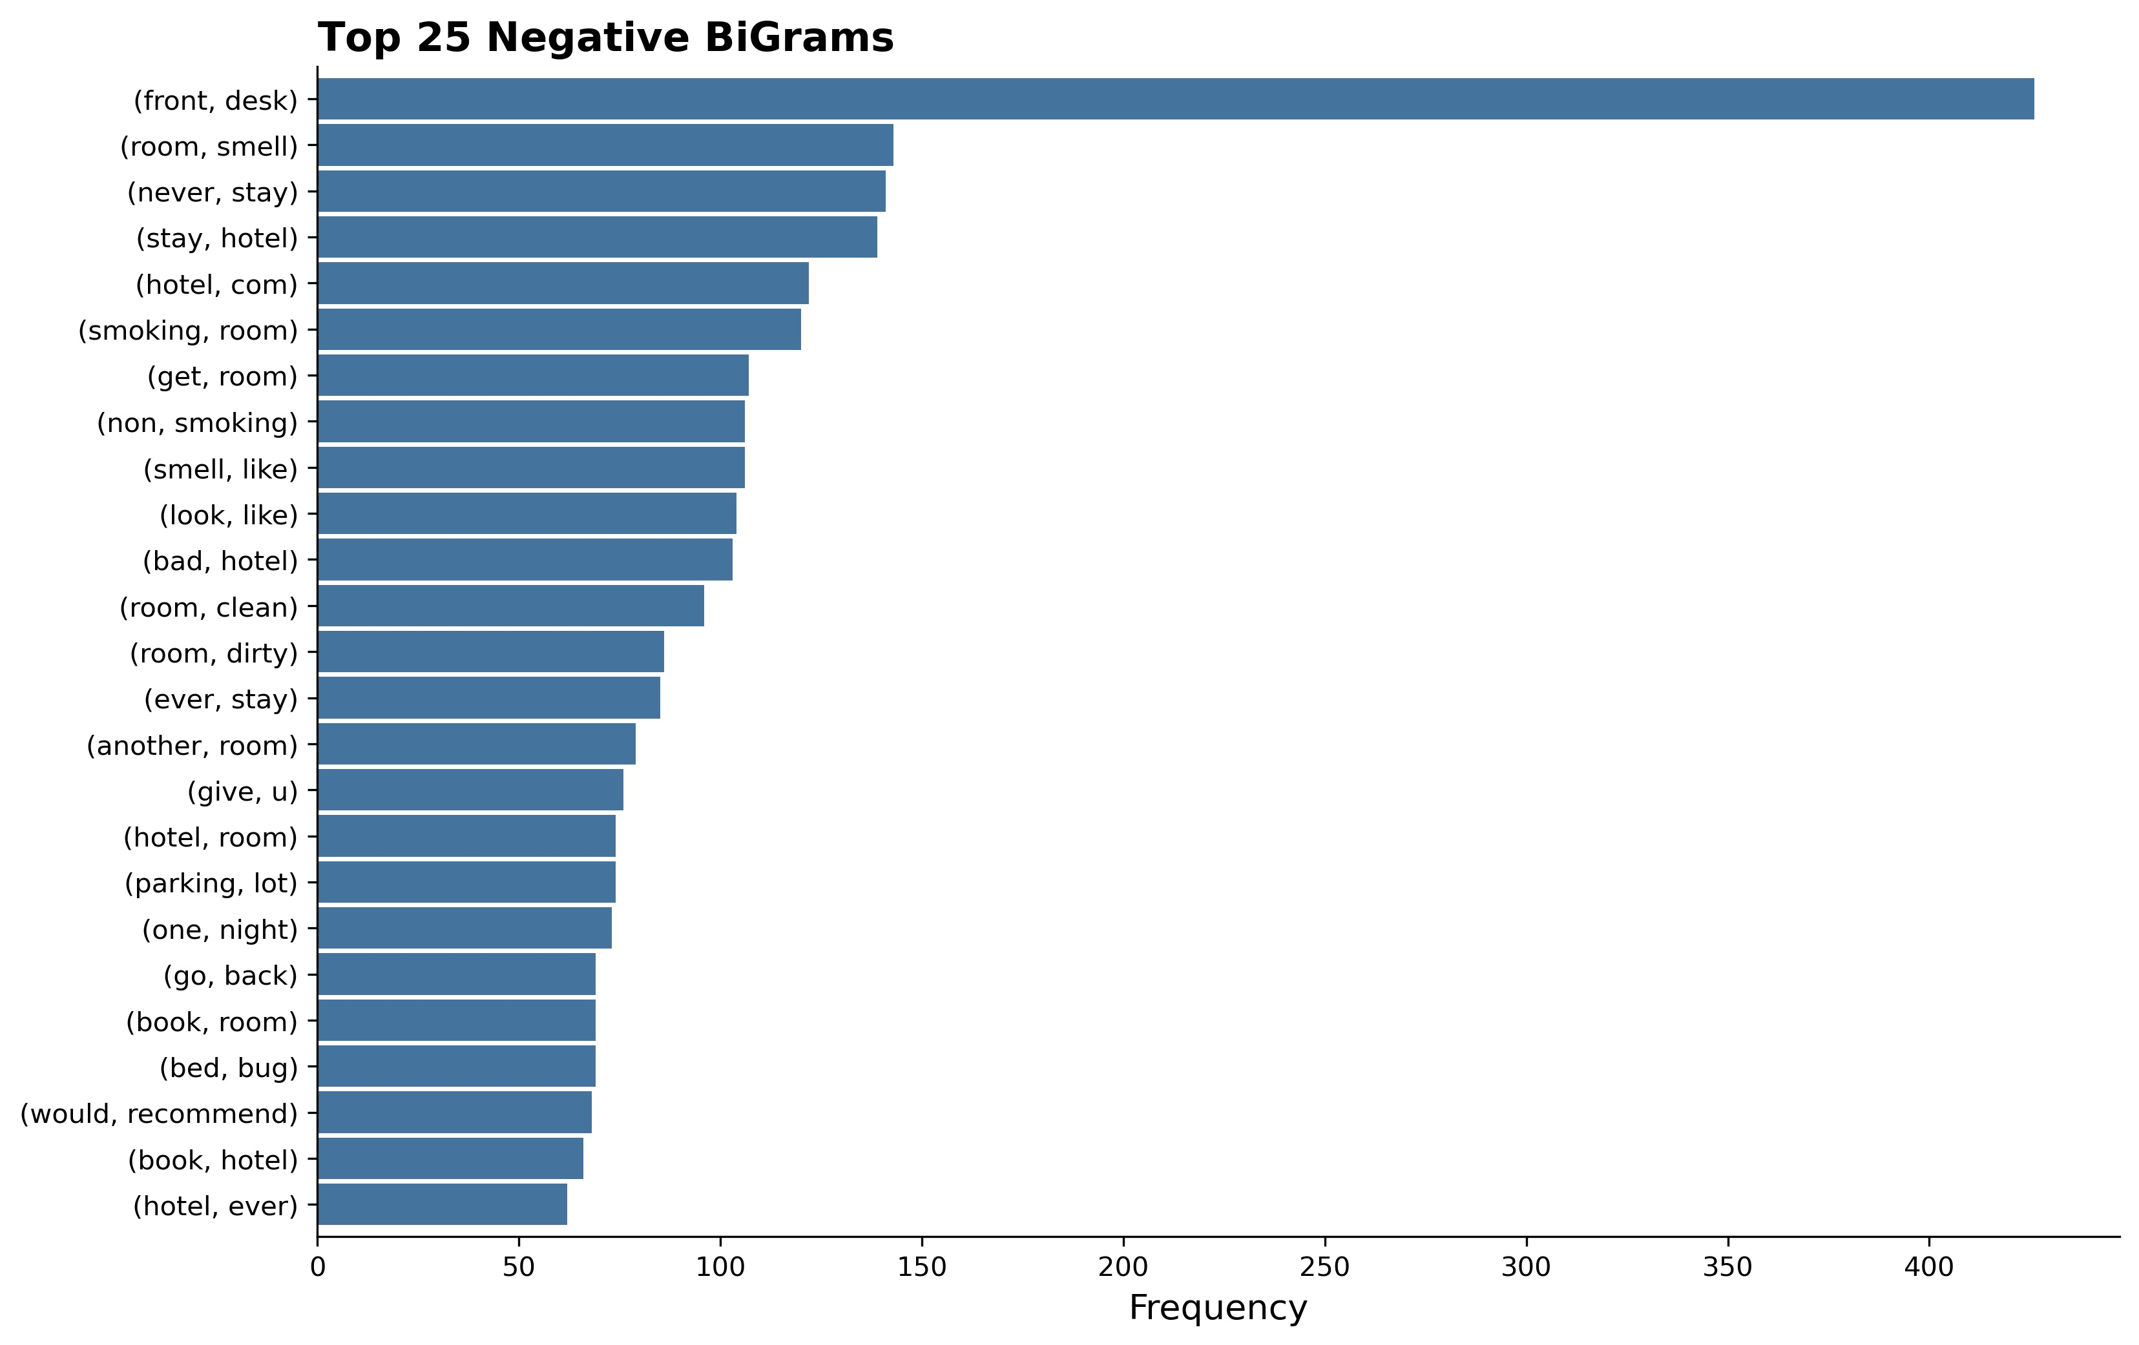
Text-Link Analysis: Negative
BiGram Feelings
One -
Towel
Pillow
Employee
Room -
Smell
Dirty
Filthy
426
143
Bad -
Experience | Price
Wifi | Room
Service | Breakfast
TriGram Feelings
Go -
Front Desk/Back Desk
Anywhere/Somewhere Else
Room Key
Check, Disappoint, Call

Slide 13
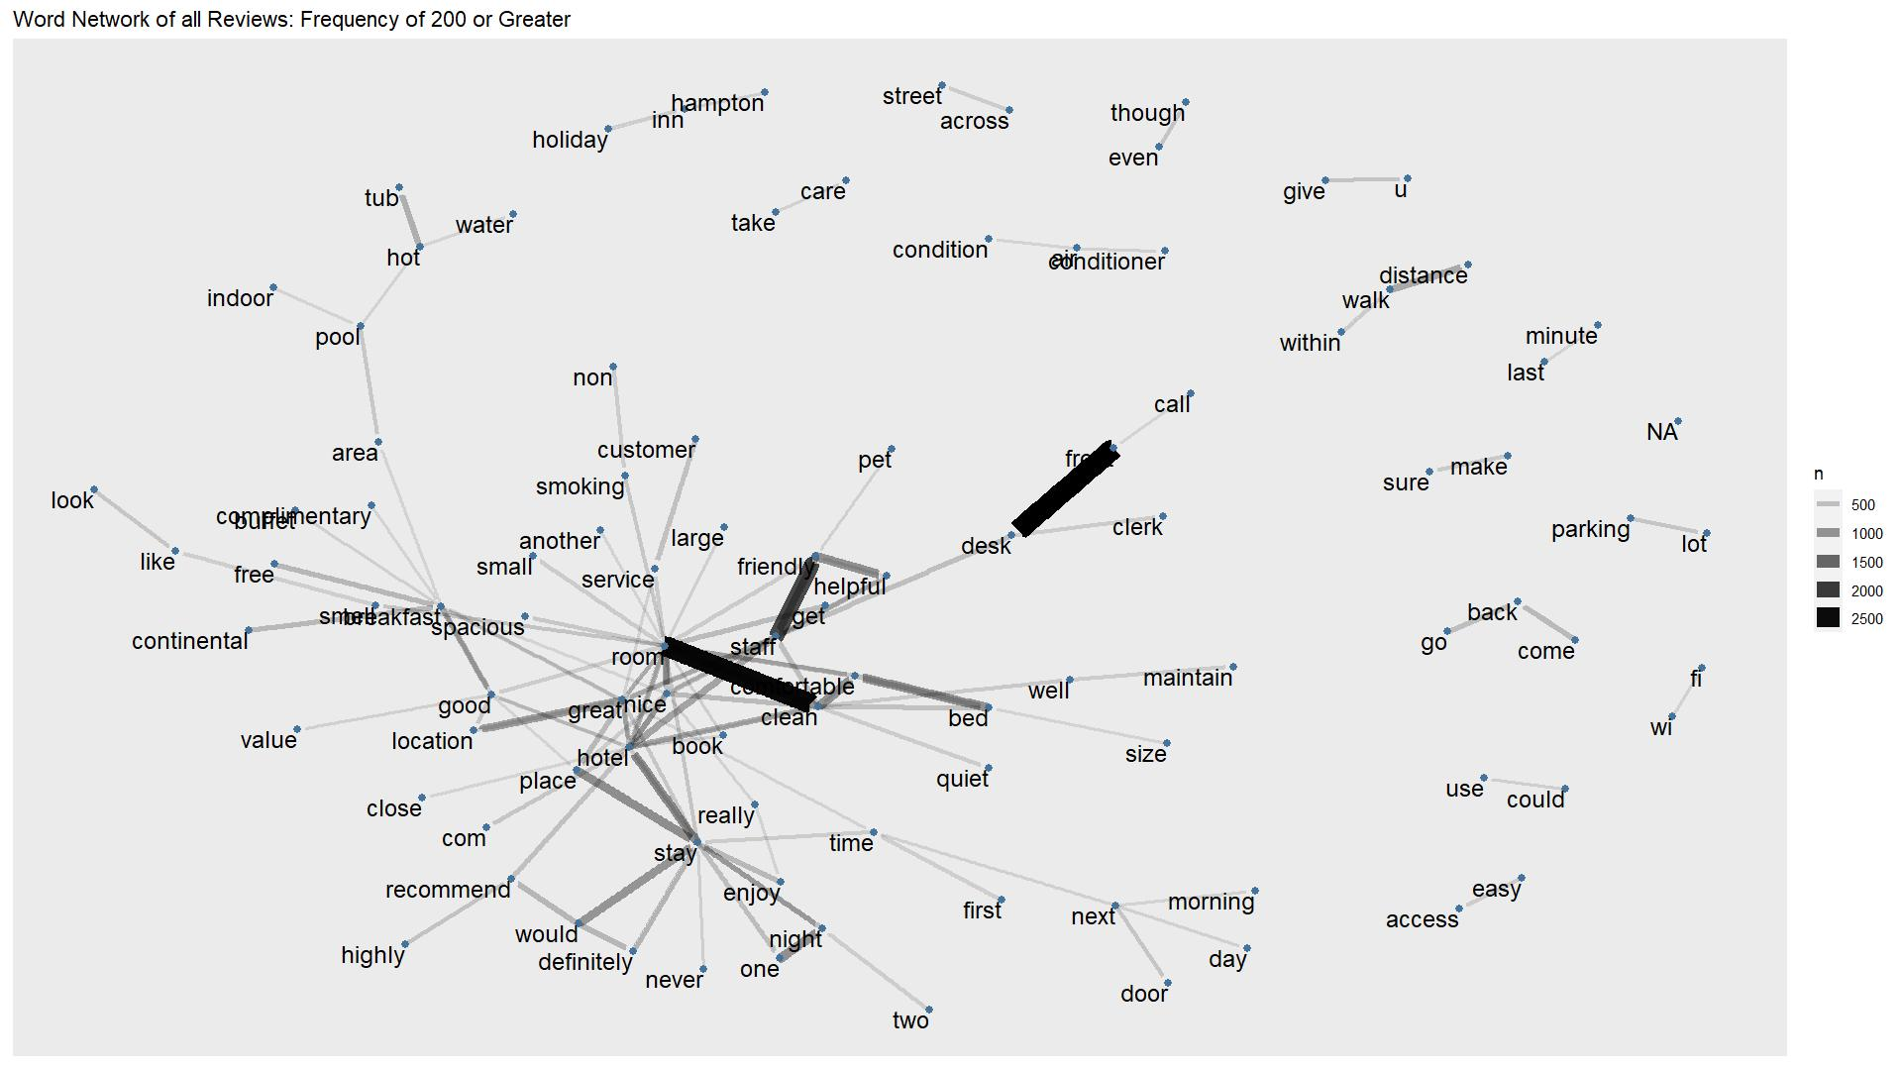
Network Graph All Reviews

Slide 14


Inverse Document Frequency
Term Frequency – Inverse Document Frequency (TD-IDF):
How often a word appears in a single review in relation to how many times that word is in other reviews
Positive
Negative
Word | TD-IDF Score
Aircon | 0.407
Mosquito | 0.398
Sea | 0.286
Word | TD-IDF Score
Centipede | 0.441
Fly | 0.175
Skylight | 0.116

Slide 15
Closing
Text mining hotel reviews can offer high perspective to understand the hotel market
What guests write about often is the first impression a new guest receives of the hotel
Themes and topics can be gathered through text mining of these thoughts Rooms Cleanliness Staff Amenities Area
Hotels Managers Marketing – use most popular themes Evaluate amenities – upgrade or change offerings Training & Staffing – praise or adjust training programs and staffing levels

Slide 16
Thank you!

